Slide 1
Work content
wrf361serial_torch
Build Docker Images
Compile WRF exe
wrf361_torch
Add wrf environment
cuda_torch
Add libtorch library
nvidia/cuda 11.2.2-cudnn8-devel-ubuntu18.04
Base CUDA&Cudnn environment

Slide 2
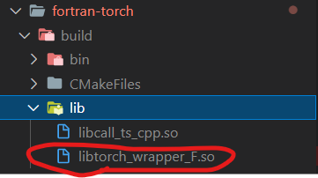
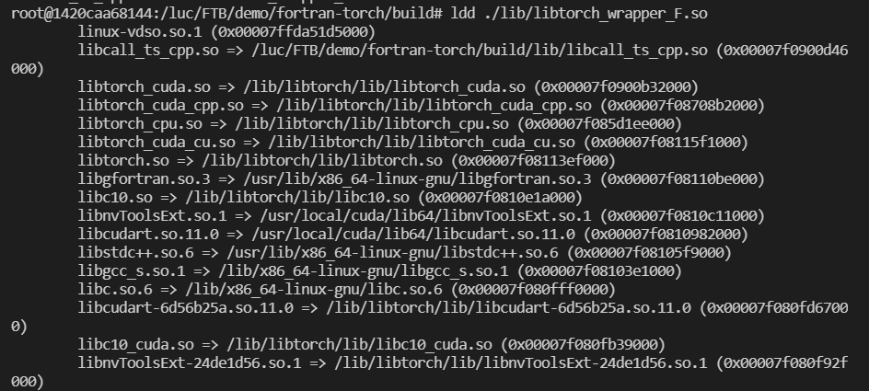
Work content
Build fortran_torch wrapper into dynamically linked libraries (*.so)
C++ dependencies
Libtorch
Notice:
This step should be applied in the same environment with next step building WRF.

Slide 3
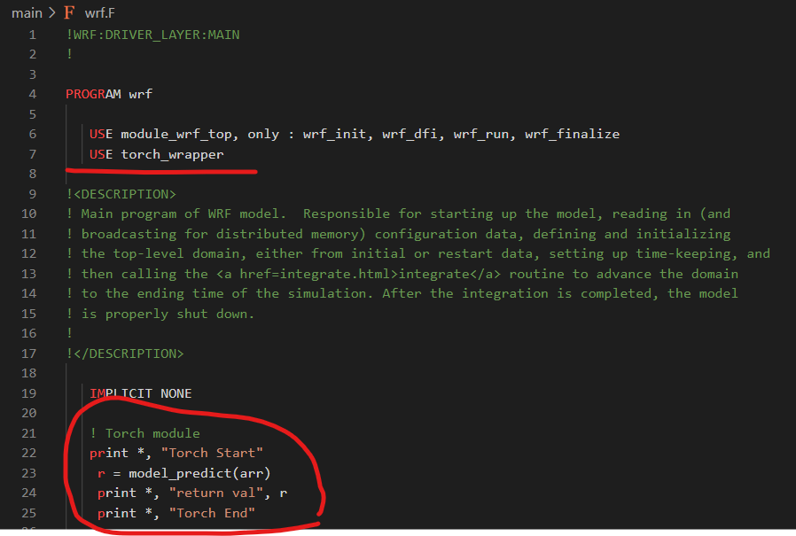
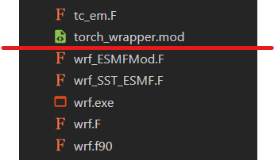
Work content
Change WRF compilation configuration and build WRF
EDIT configure.wrf & ADD libtorch_wrapper.so path into `LD_LIBRARY_PATH`
ADD torch_wrapper.mod
EDIT main/wrf.F

Slide 4
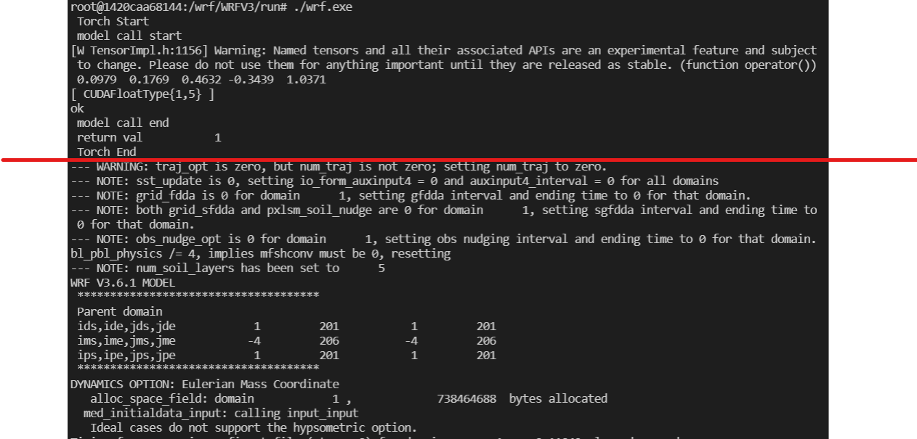
Work Content
RUN WRF
Torch
(GPU)
WRF
(CPU)

